Slide 2
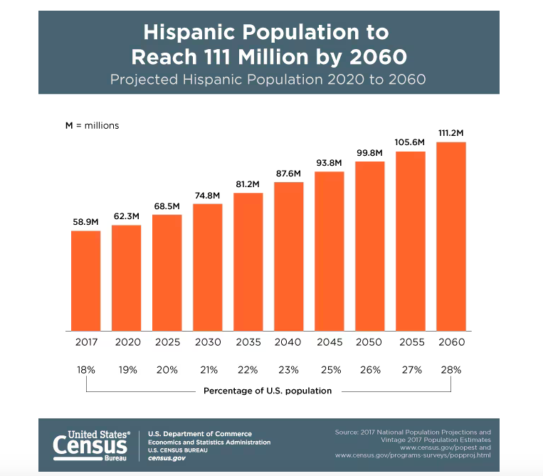

Slide 3
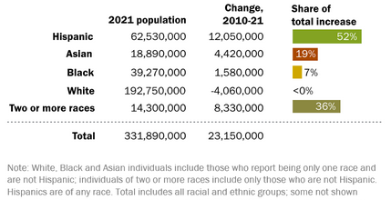

Slide 4
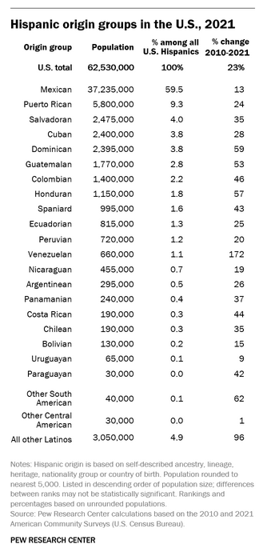
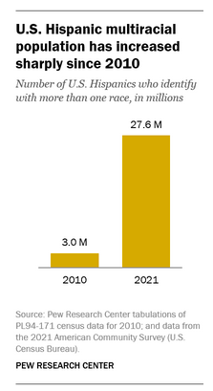

Slide 5
Hispanics/Latinos in Medicine

Slide 6
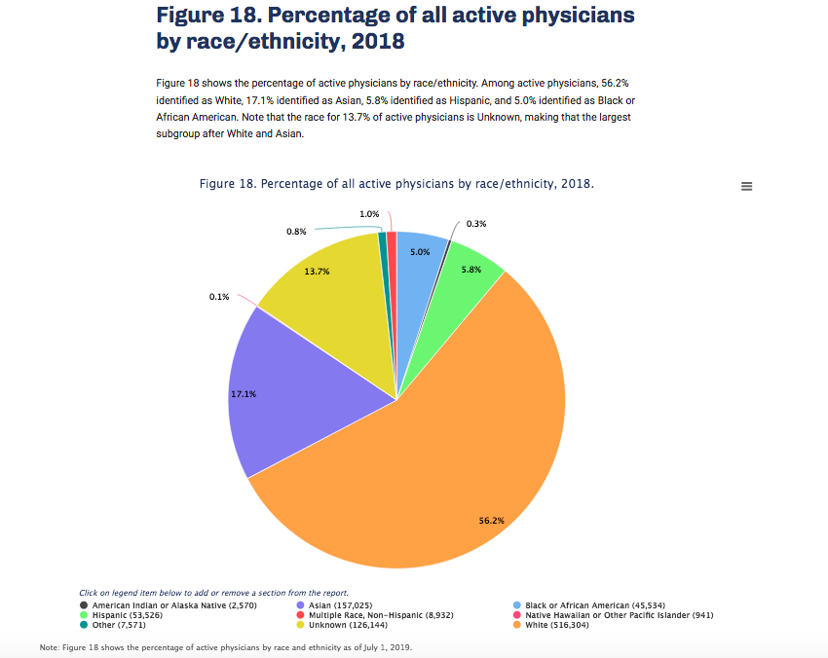

Slide 7
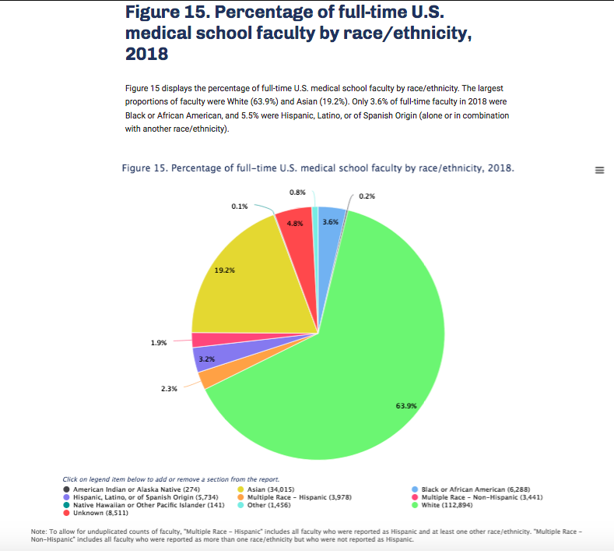

Slide 8
2018 Percentage of Full-time U.S. Medical School Faculty by Sex and Race/Ethnicity

Slide 9
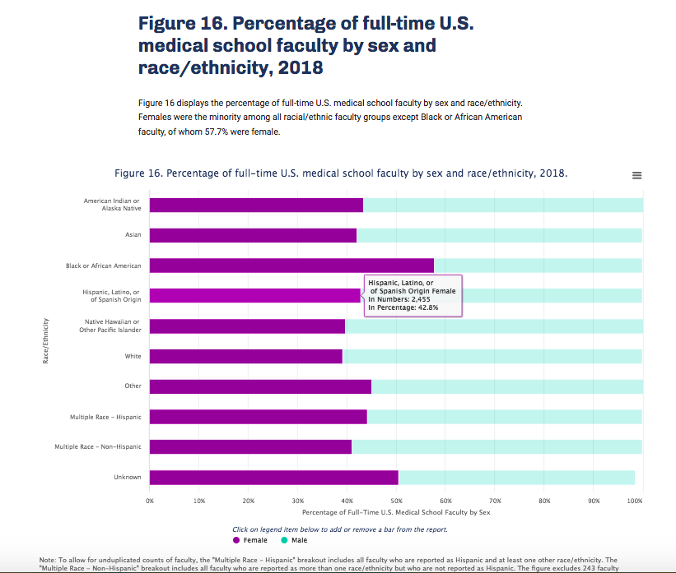

Slide 10
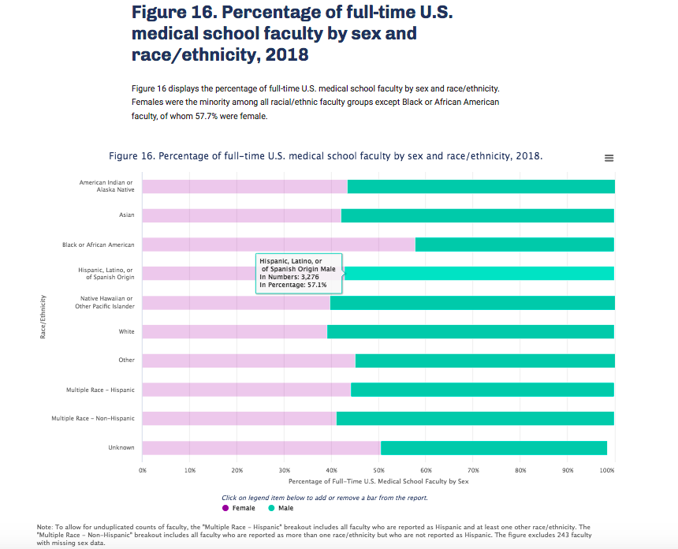

Slide 12
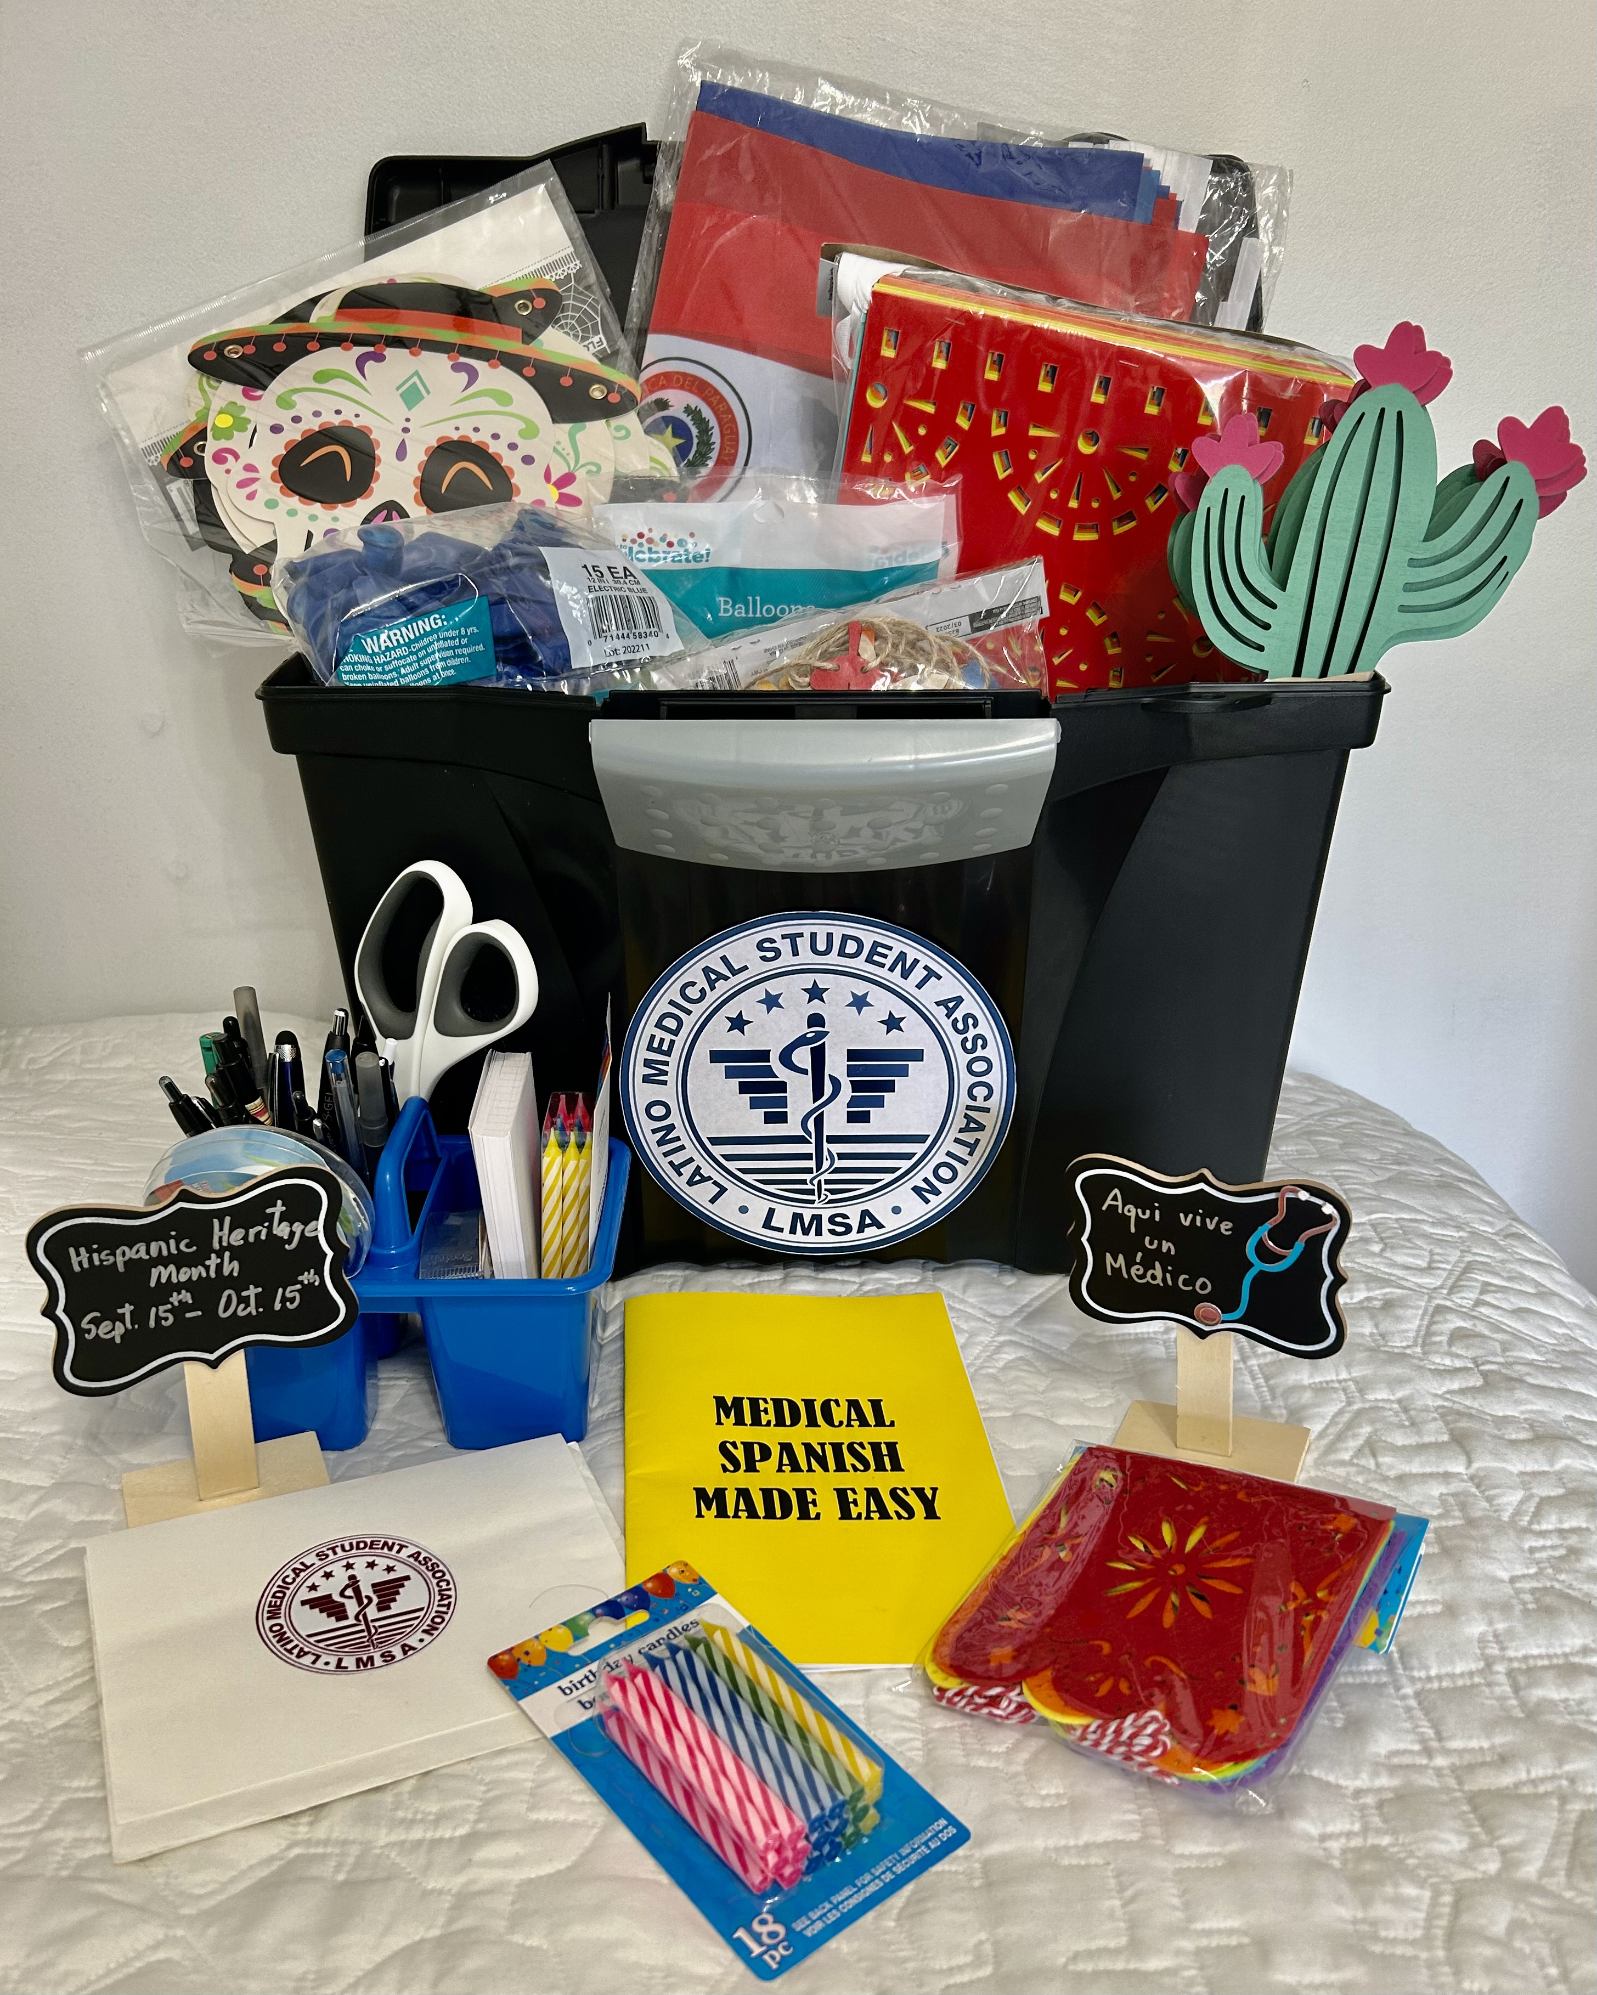
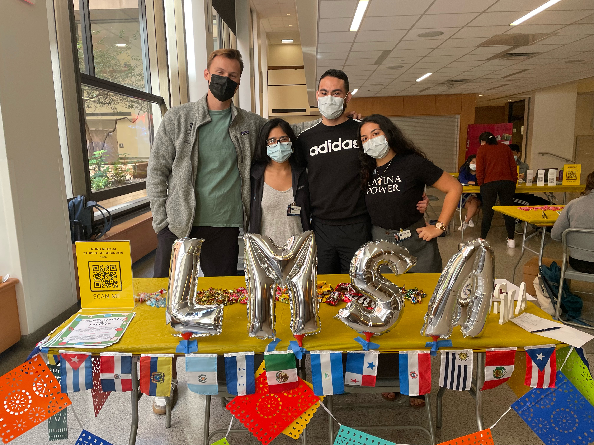
LMSA Events Tool Kit

Slide 13
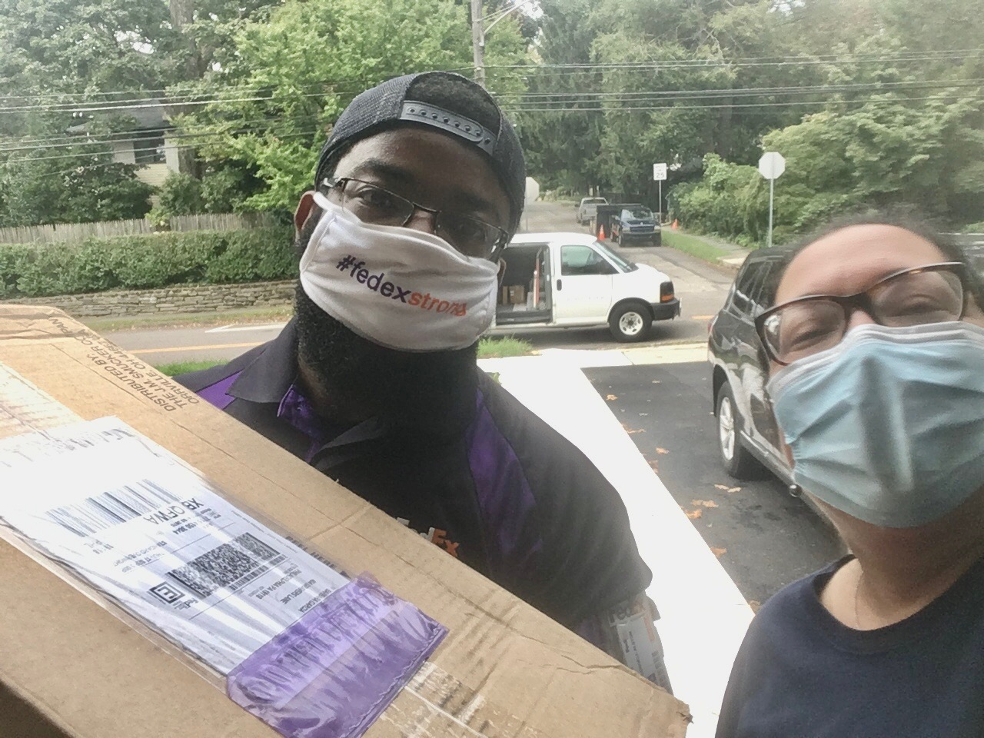
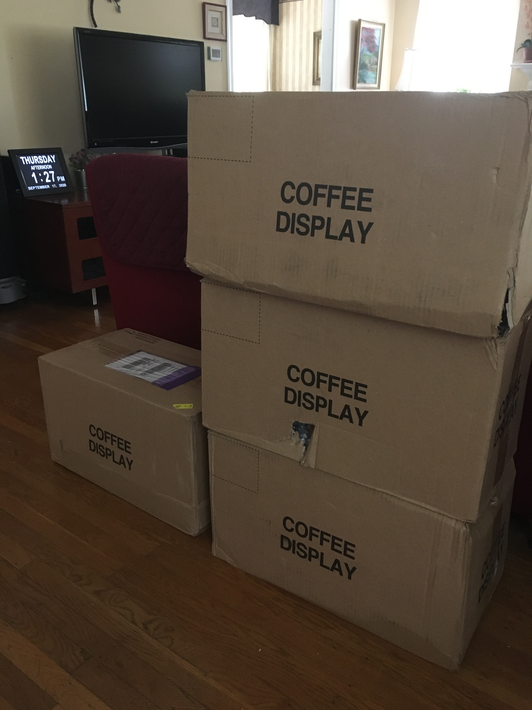

Slide 15
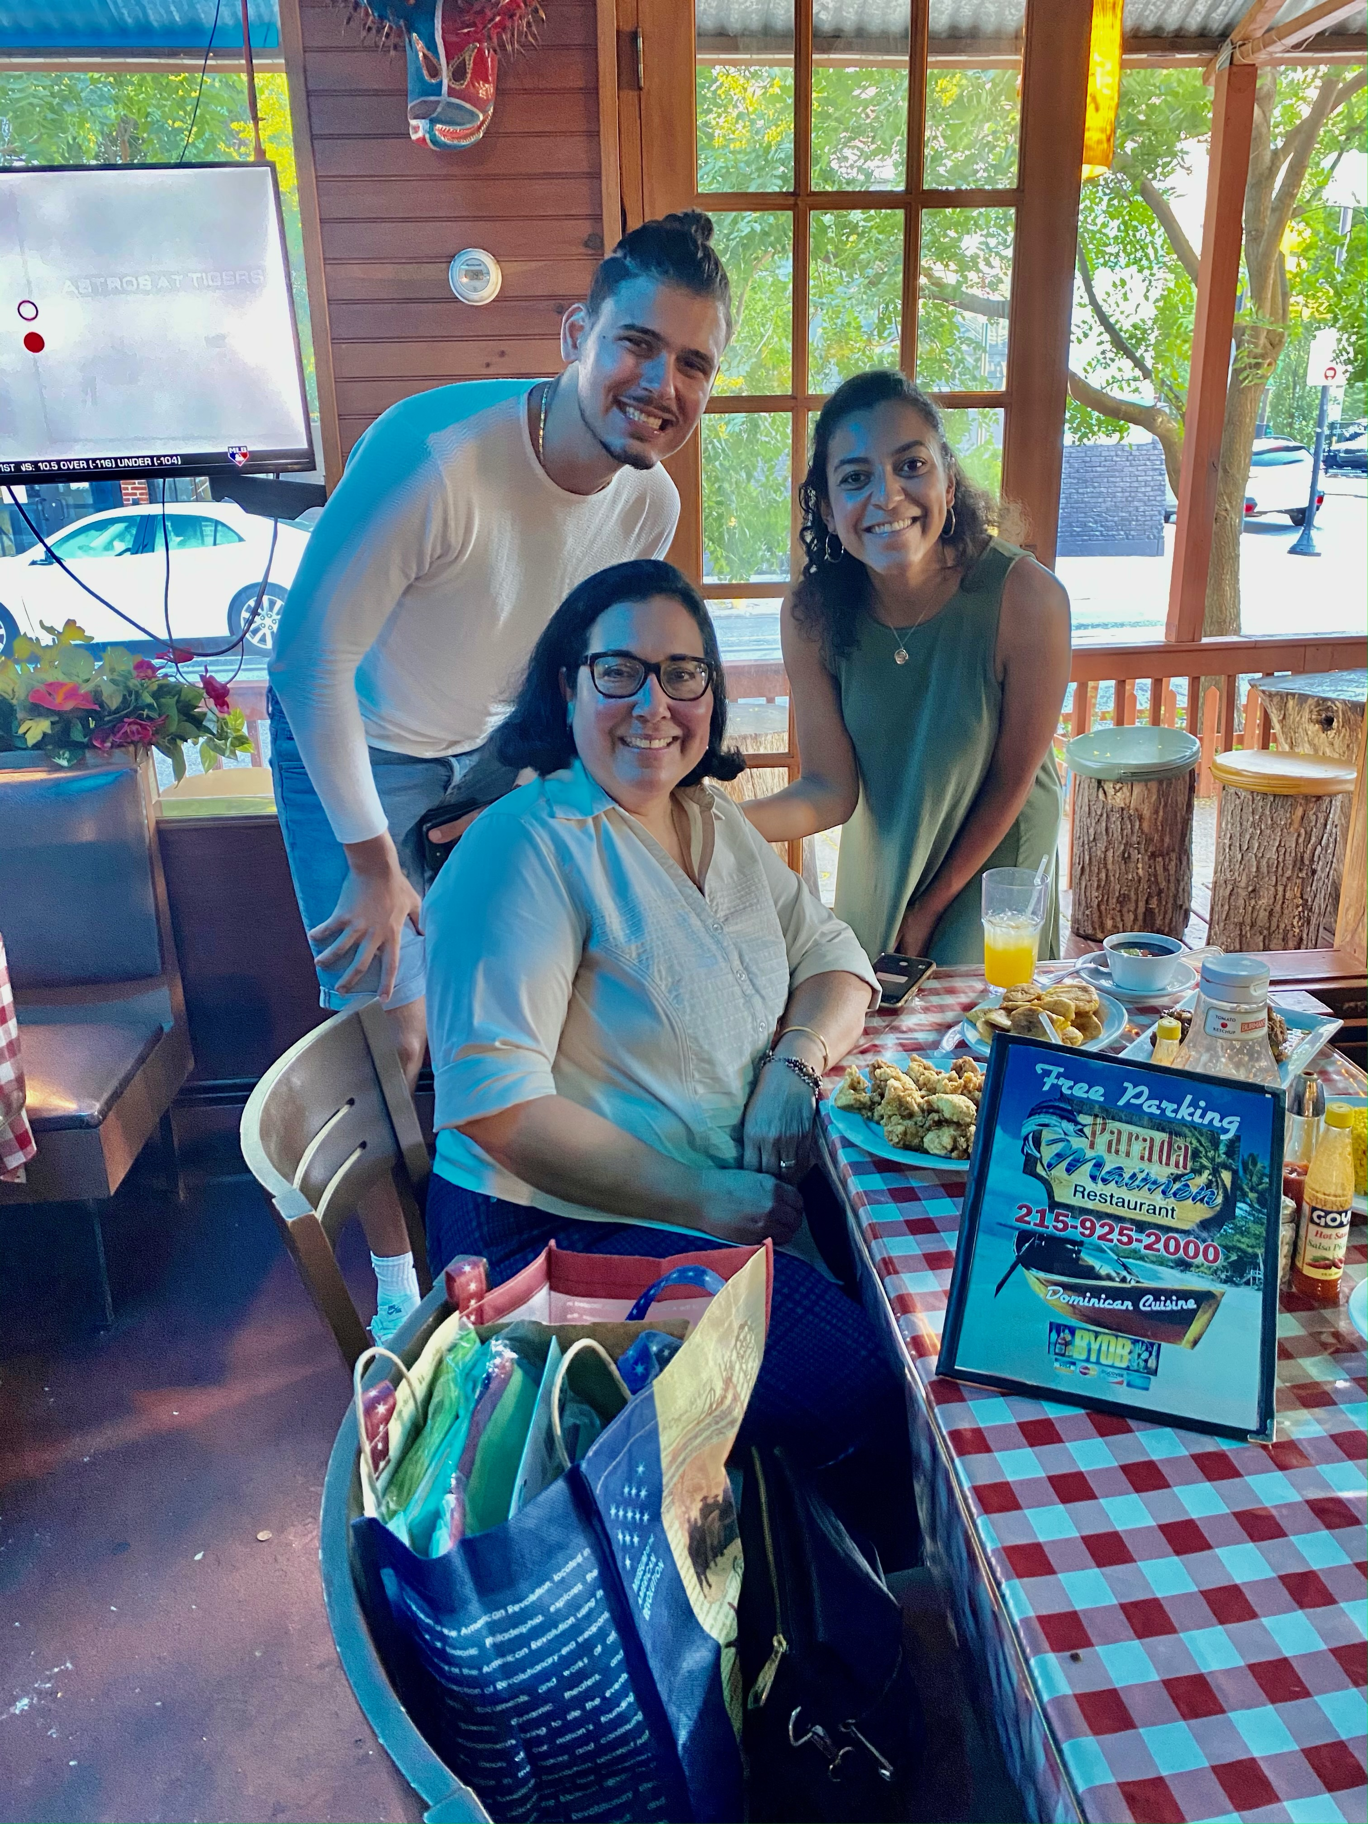
Temple University
Lewis Katz School of Medicine
LMSA

Slide 16
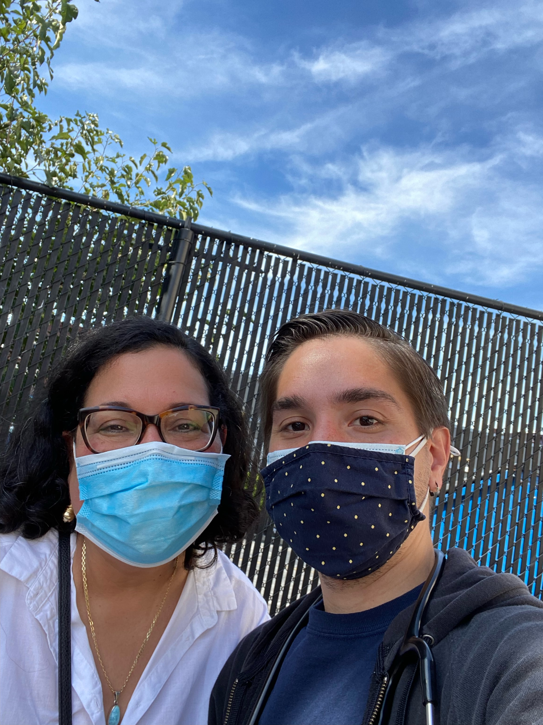
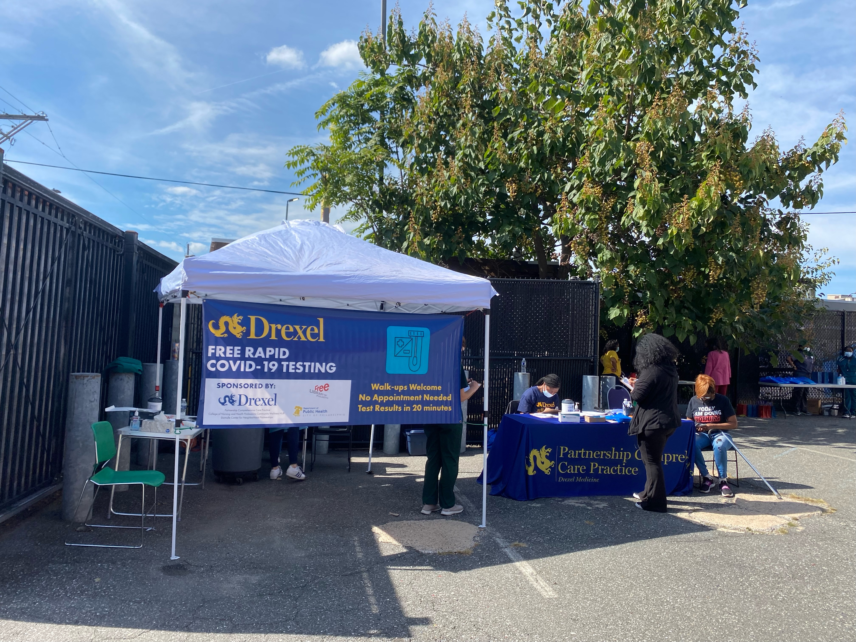
Drexel University
College of Medicine

Slide 17
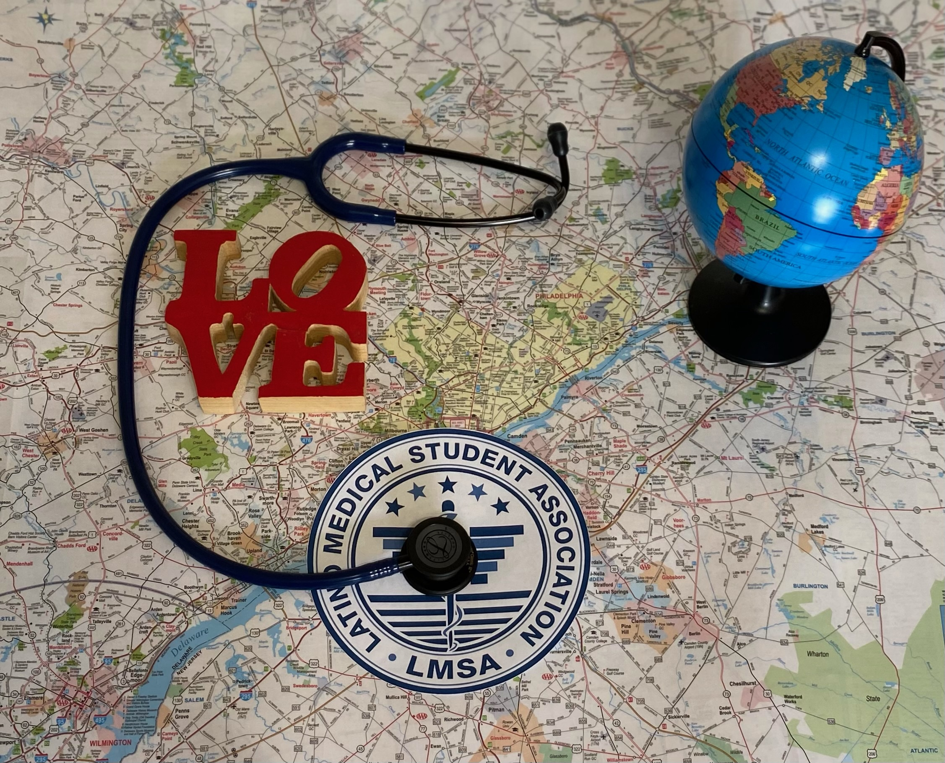
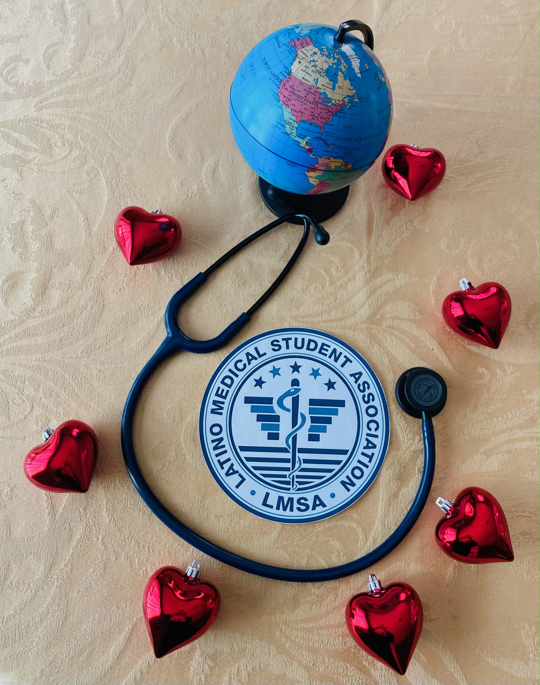

Slide 19
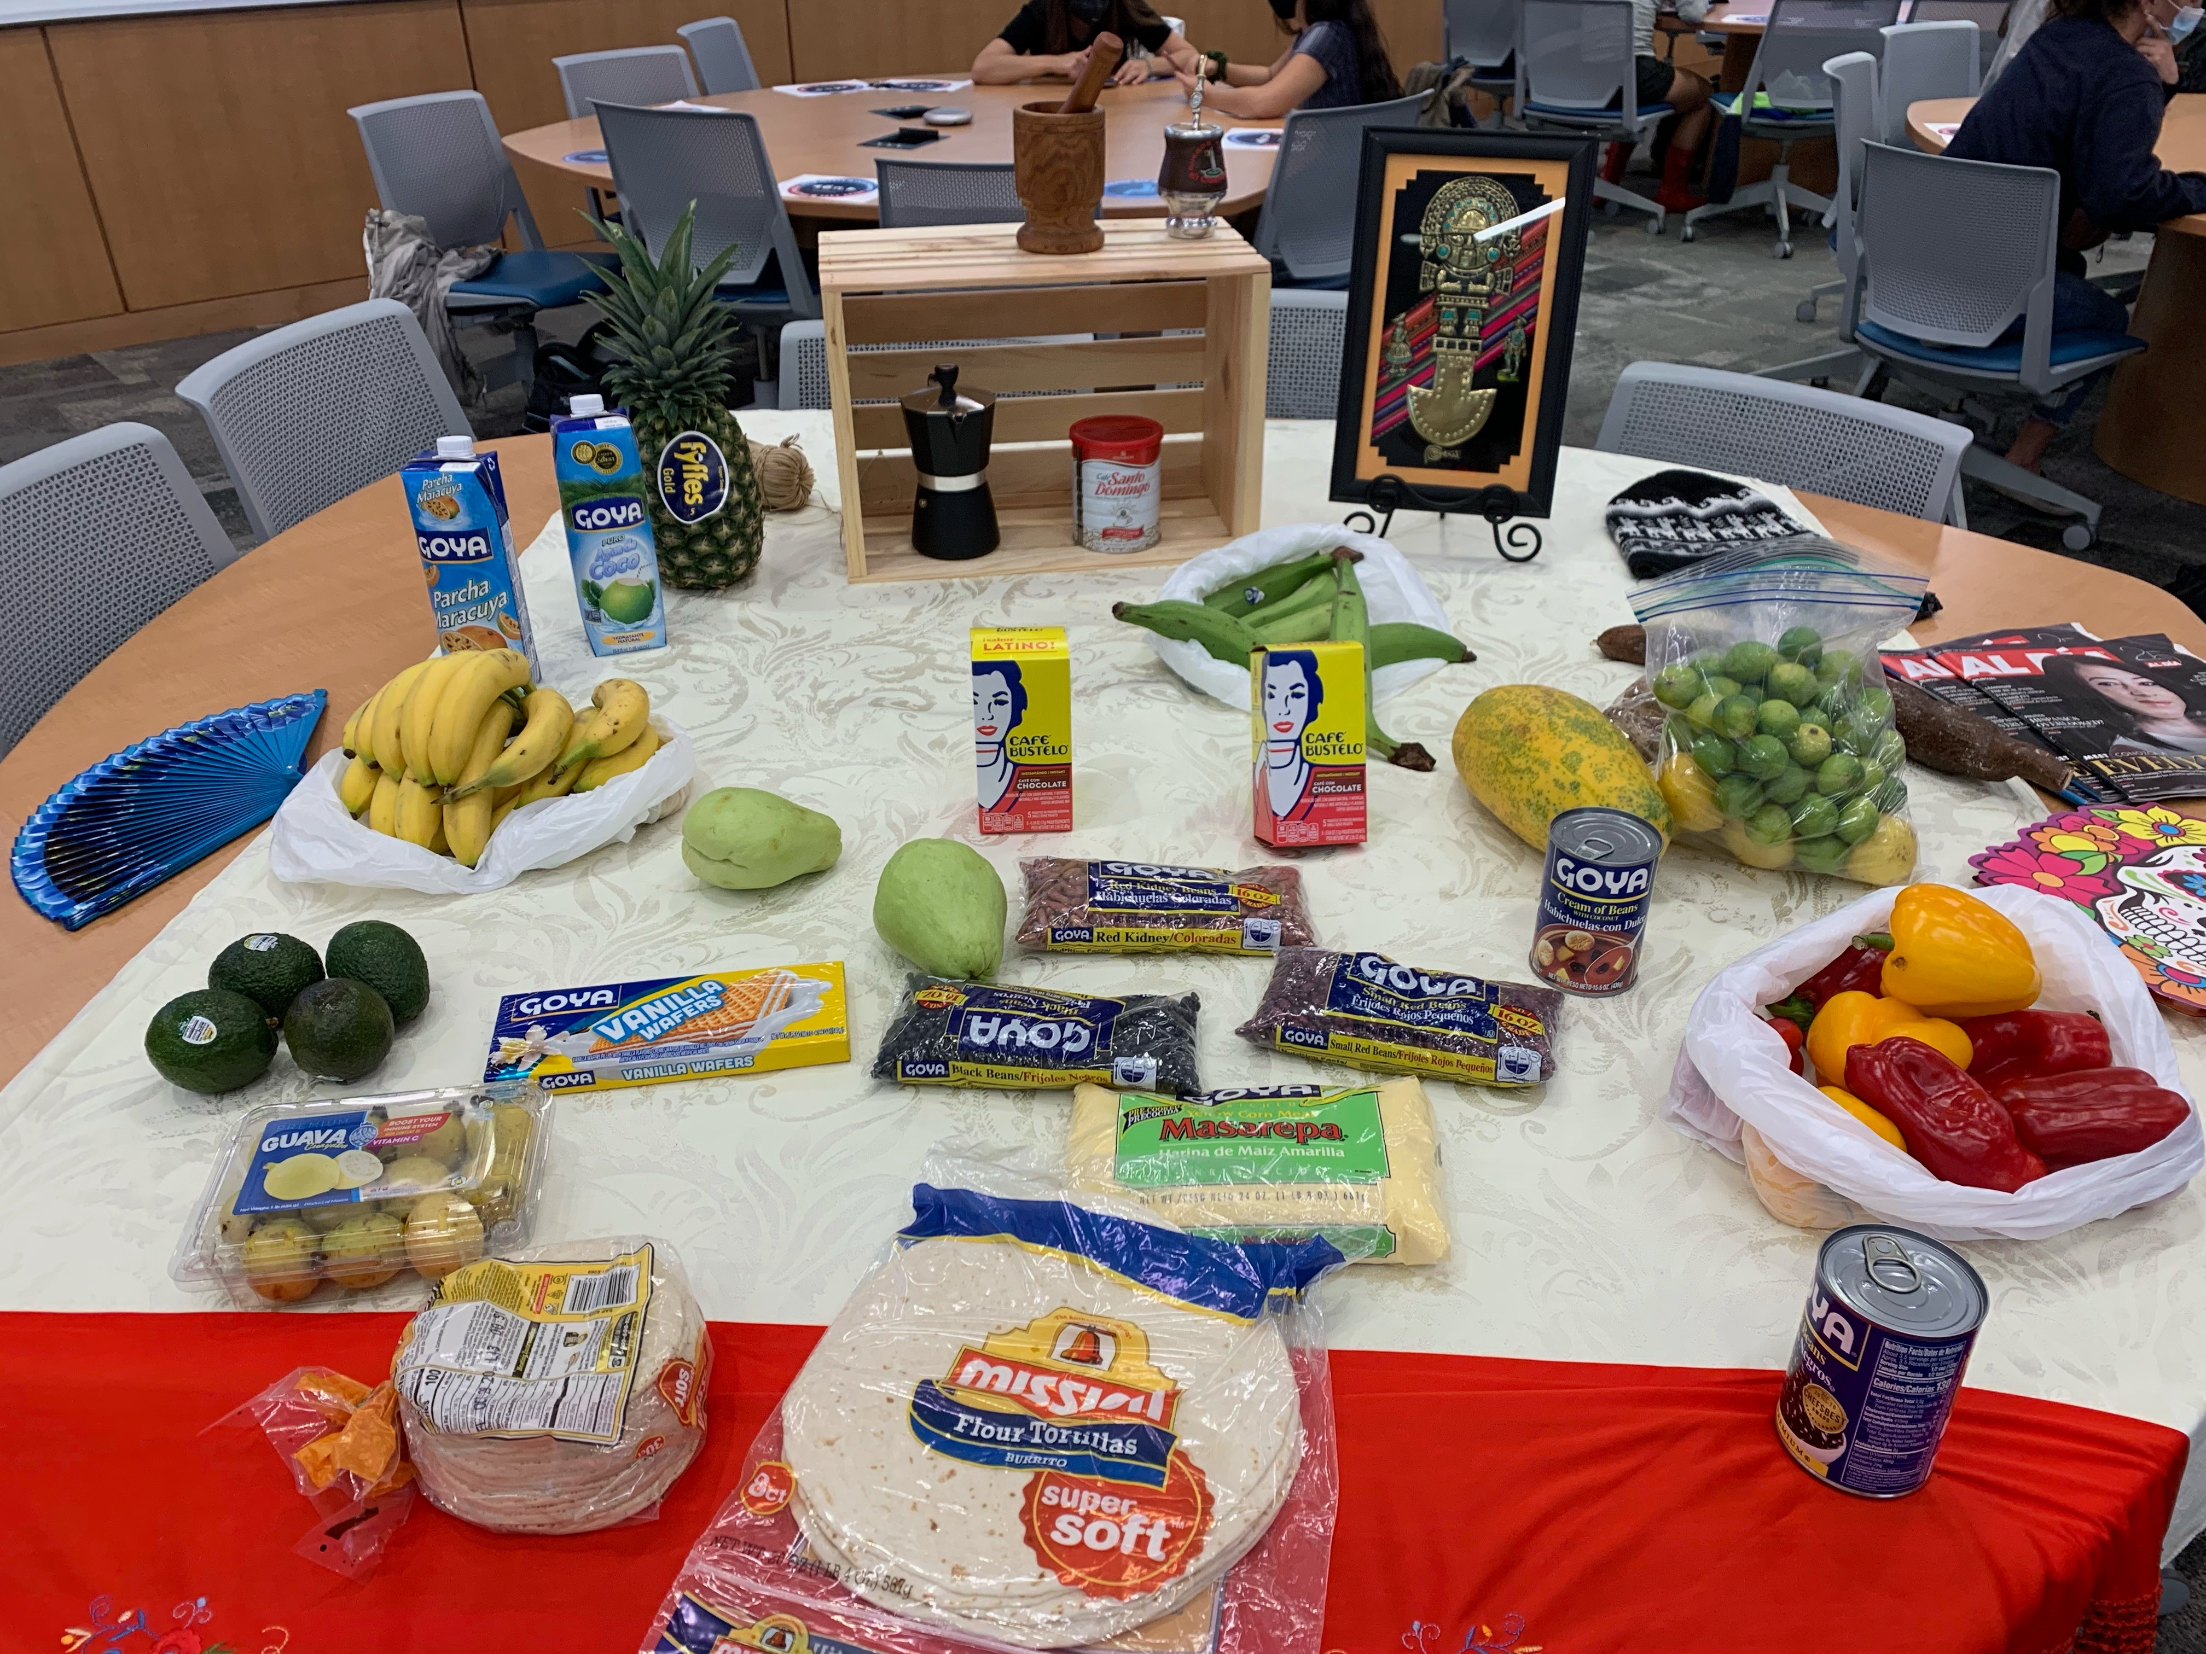
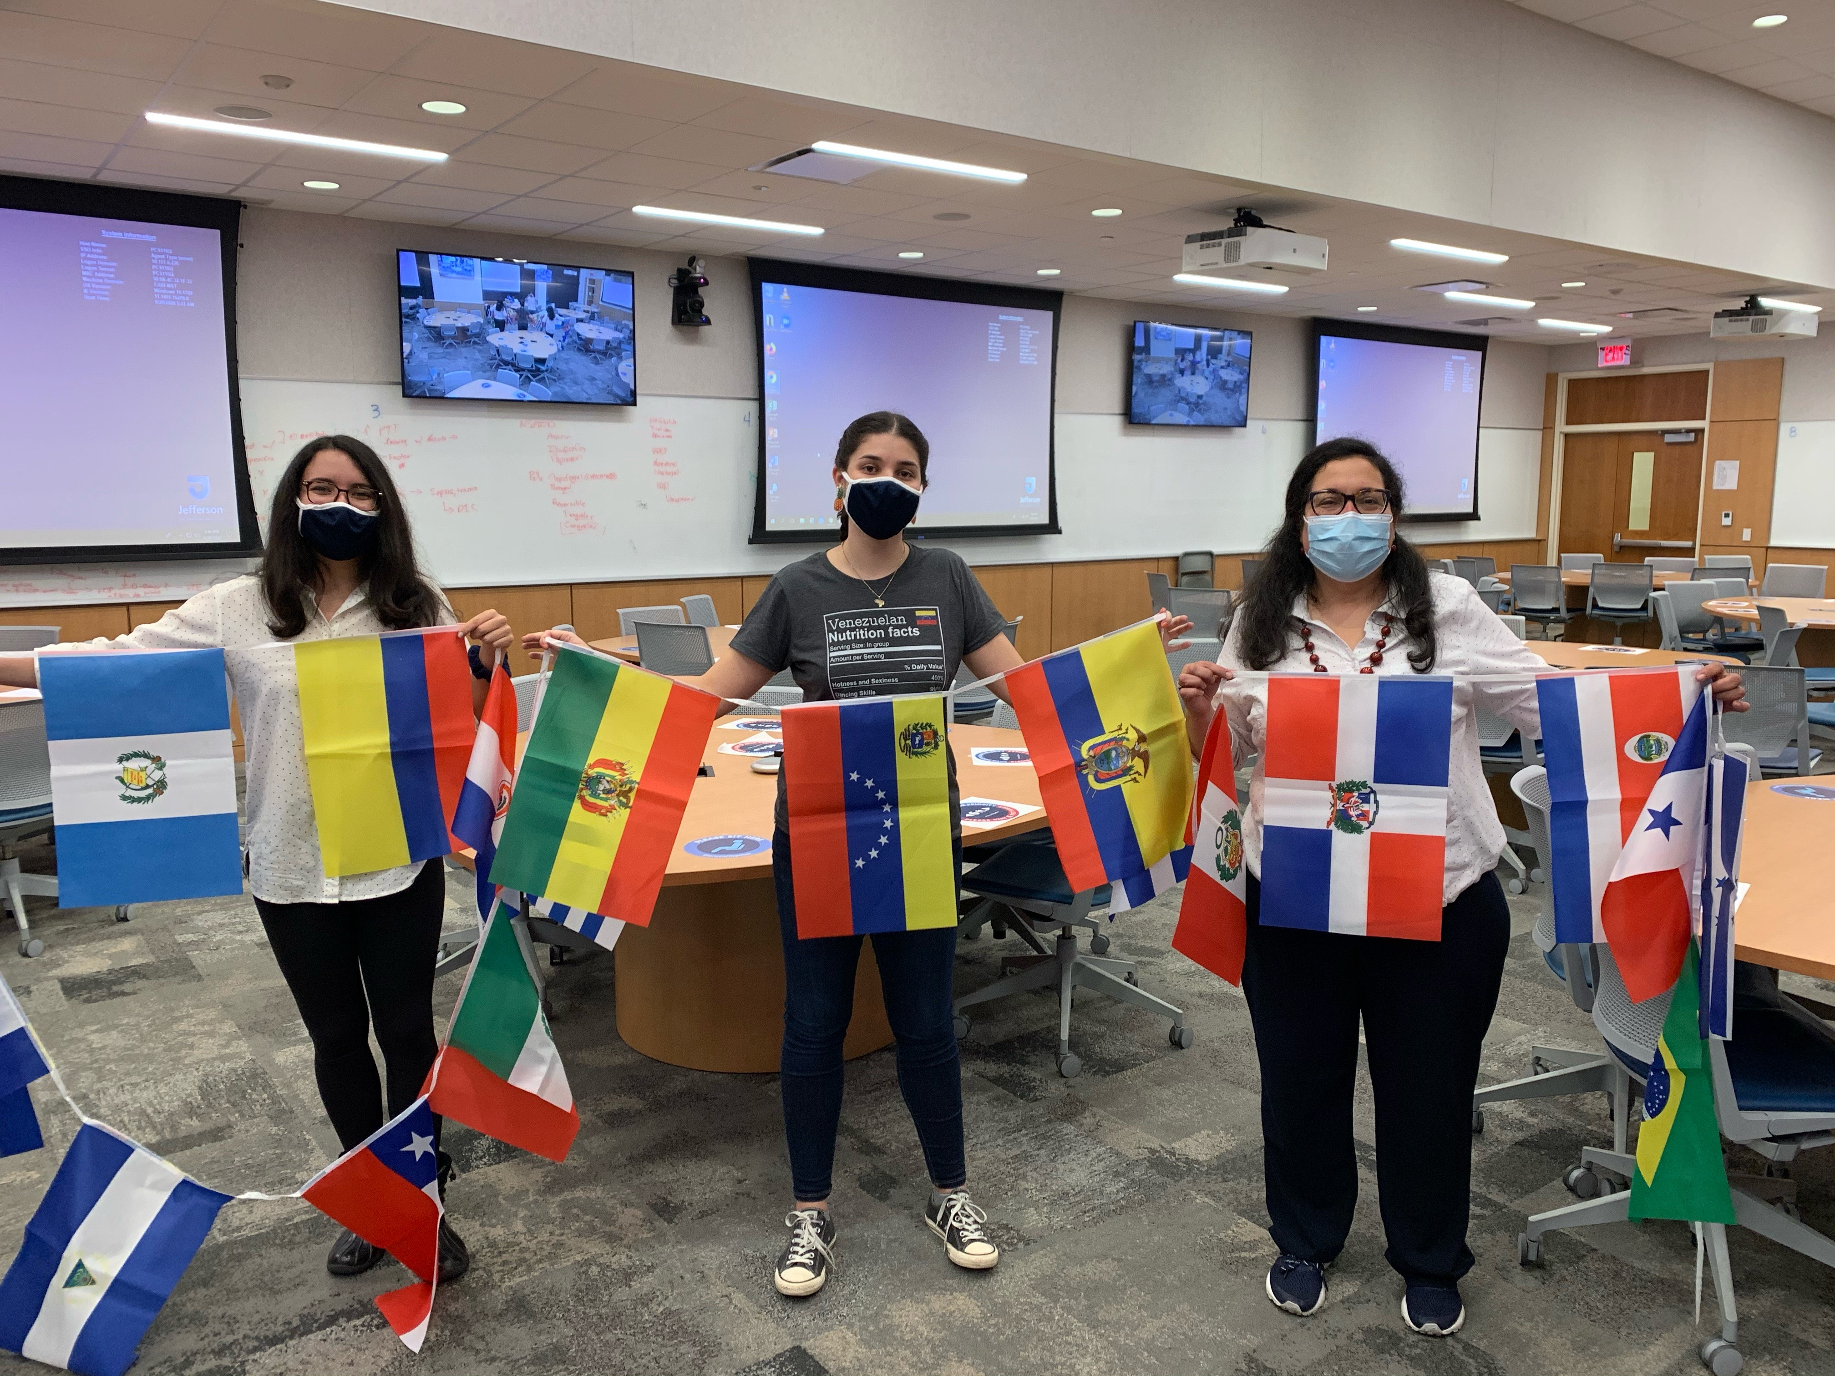

Slide 20
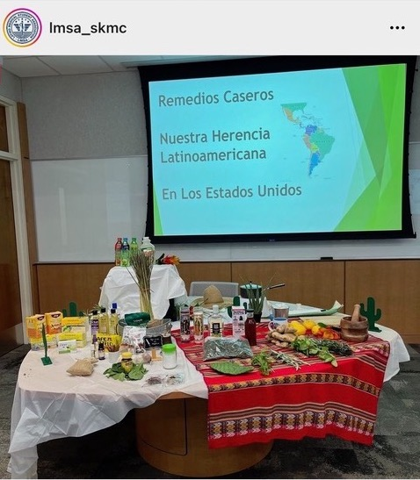

Slide 21
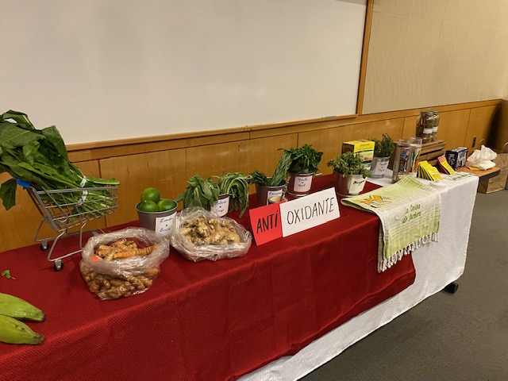
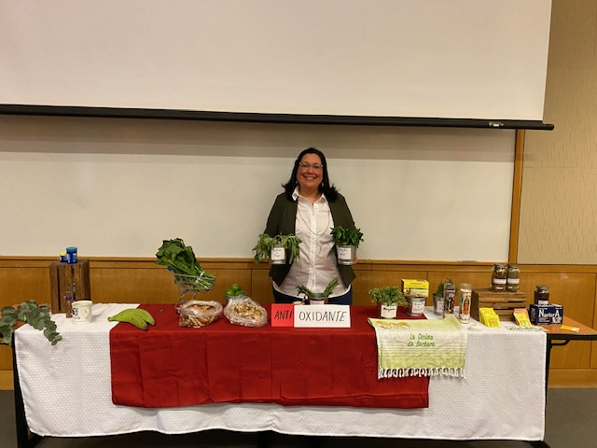

Slide 22
“There is power in being seen, and there is strength in documenting our stories”
-Kennedi Carter-

Slide 23
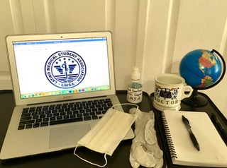
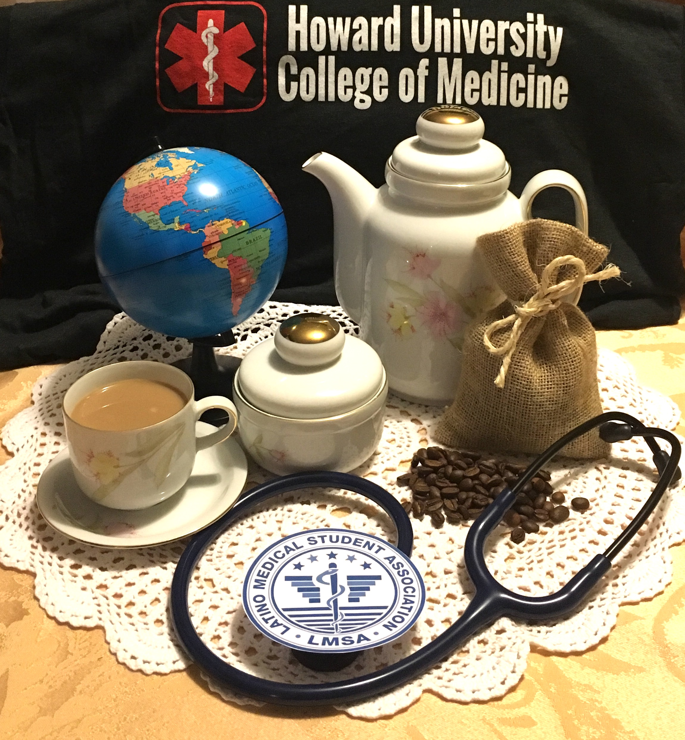

Slide 24
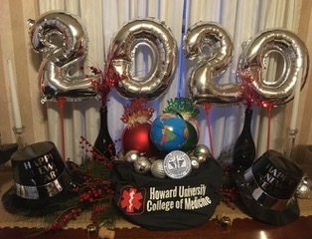
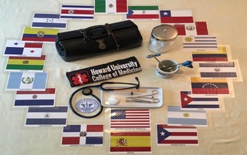

Slide 25
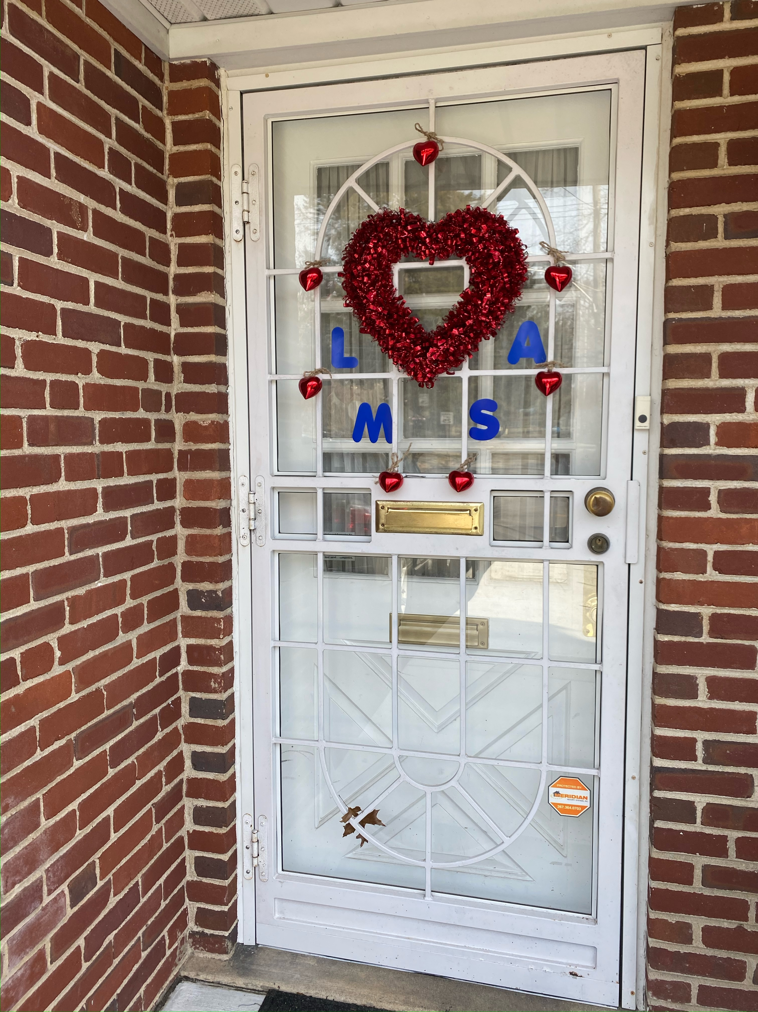
“If you talk to a man in a language he understands, that goes to his head.
If you talk to him in his own language, that goes to his heart.”
-Nelson Mandela

Slide 26
https://www.aamc.org/data-reports/workforce/report/diversity-medicine-facts-and-figures-2019
https://www.pewresearch.org/short-reads/2022/09/23/key-facts-about-u-s-latinos-for-national-hispanic-heritage-month/

